Slide 1
Limited Arbitrage in Equity Markets -Mark Mitchell, Todd Pulvino and Erik Stafford
Topics in Quantitative Finance
- Richa DeogaonkaR Date: 09/13/2016

Slide 2
What is Arbitrage?
- True Arbitrage is the simultaneous purchase and sale of an asset to profit from a difference in the price.
- A free Lunch?

Slide 3
Contents
1. Introduction
2. Data Description
3. Measuring Investment Return
4. Fundamental Risk
5. Financing Risk
6. Arbitrage in Imperfect Capital Markets
7. Conclusion

Slide 4
Introduction
- To examine the impediments to Arbitrage in Equity Markets
- Imperfect Information, Market Frictions Impede, uncertainty over economics, uncertainty over distribution of returns, huge fixed costs, diversification impede Arbitrage
- Studied a sample of 82 companies where the market value of the company is less than that of its ownership stake in a publicly traded subsidiary- Negative Stubs

Slide 5
Contents
1. Introduction
2. Data Description
3. Measuring Investment Return
4. Fundamental Risk
5. Financing Risk
6. Arbitrage in Imperfect Capital Markets
7. Conclusion

Slide 6
Data Description
A] Sample Selection Criteria
Stub Assets: the market value of the parent's equity less any measurable net assets-net of the parent's unconsolidated liabilities.
V_{Stub} =MV_{Equity} - MV_{Stake} - [MV_{OtherAssets} - MV_{Liabilities}]
Rule 1: V_{stub} <0 if MV_{Stake} / MV_{Parent Equity} <1.0
Rule 2: V_{stub} <0 if MV_{Stake +} BV _{Parent Equity} / MV_{Parent Equity} <1.0

Slide 7
Data Description
B] Sample Construction
Using a two step process-
1. First, we search the Securities Data Corporation (SDC) database from 1985 through 2000 for all initial public offerings (IPO) where another publicly traded firm owned the IPO shares prior to the offering.
2. Second, we search the financial press and trade publications for extreme relative value situations during the 1985 to 2000 period.

Slide 8
Data Description
C] Shares outstanding, Returns and Rebates
- To estimate the stub value in cross-holding situations, the number of parent shares outstanding and the number of subsidiary shares held by the parent are needed.
- Short rebate refers to the rate paid to investors on the proceeds obtained from short selling a stock.
-Short-rebate data from Ameritrade Holding Corporation, a large online re- tail broker. This short-rebate data covers the December 1998 through October 2000 time period.

Slide 9
Contents
1. Introduction
2. Data Description
3. Measuring Investment Return
4. Fundamental Risk
5. Financing Risk
6. Arbitrage in Imperfect Capital Markets
7. Conclusion

Slide 10
Measuring Investment Return
A] Investment Criteria and Thresholds
Rule 1:
Place trade if MV_{Stake} / MV_{Parent Equity} > Buy threshold
Terminate trade if MV_{Stake} / MV_{Parent Equity} < Sell threshold
Rule 2:
Place trade if MV_{Stake +} BV _{Parent Equity} / MV_{Parent Equity} > Buy Threshold
Terminate trade if MV_{Stake +} BV _{Parent Equity} / MV_{Parent Equity} <Sell Threshold

Slide 11
Measuring Investment Return
B] Investment Capital and Financial Leverage
Textbook Leverage: Post Collateral for both long and short positions to satisfy minimum initial capital requirements imposed by Federal Reserve Board.
Regulation T Leverage: Sets boundaries for initial maximum amount along with minimum maintenance margin.
Conservative Leverage: It precludes all margin calls ex post and cannot be determined ex ante.

Slide 12
Measuring Investment Return
C] Assessing Investment Performance
- Mean Annualized returns in excess of the risk free rate.
- Frequency of negative returns
- Frequency of margin calls

Slide 13
Contents
1. Introduction
2. Data Description
3. Measuring Investment Return
4. Fundamental Risk
5. Financing Risk
6. Arbitrage in Imperfect Capital Markets
7. Conclusion

Slide 14
Fundamental Risk
In this paper, fundamental risk refers to the possibility that the negative- stub-value trade is terminated before prices converge to fundamental values.

Slide 15
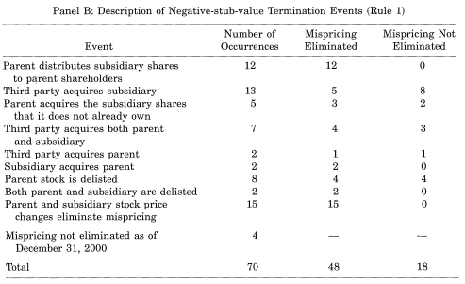
Fundamental Risk

Slide 16
Contents
1. Introduction
2. Data Description
3. Measuring Investment Return
4. Fundamental Risk
5. Financing Risk
6. Arbitrage in Imperfect Capital Markets
7. Conclusion

Slide 17
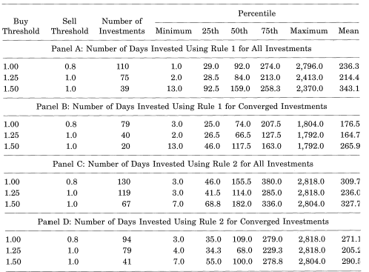
Financial Risk
A] Horizon Risk:

Slide 18
Financial Risk
B] Margin Risk:
Creative Computers/Ubid (Subsidiary)
- Creative Computer’s Total Value- $ 80million
- Ubid’s total equity value- $439million
- Creative Computer’s 80% stake- 351 million (Debt of 3 million)

Slide 19
Financial Risk
B] Margin Risk:
June 8, 1999
Each Creative Computers shareholder receives 0.7159 UBID share for 1 MALL share
December 9, 1998
MALL price is $22.75
UBID price is $35.6875
0.7159*$35.6875 = $25.55

Slide 20
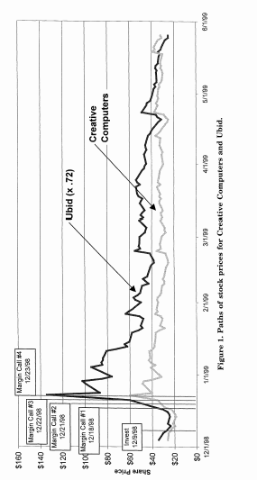
Financial Risk

Slide 21
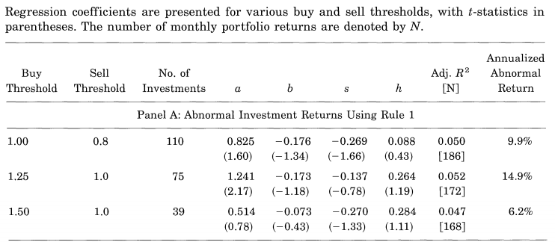
Financial Risk
Portfolio Results

Slide 22
Financial Risk
C] Specialization of the Arbitrageur
There are many arbitrage funds that engage in "special situations arbitrage," which includes negative-stub- value investments.

Slide 23
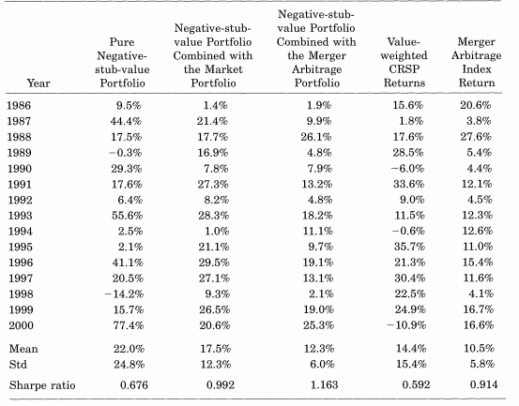
Financial Risk

Slide 24
Contents
1. Introduction
2. Data Description
3. Measuring Investment Return
4. Fundamental Risk
5. Financing Risk
6. Arbitrage in Imperfect Capital Markets
7. Conclusion

Slide 25
Arbitrage in Imperfect Capital Markets
Costs of Short Selling and Buy in risks
Imperfect Information and the Persistence of Negative Stub Values

Slide 26
Contents
1. Introduction
2. Data Description
3. Measuring Investment Return
4. Fundamental Risk
5. Financing Risk
6. Arbitrage in Imperfect Capital Markets
7. Conclusion

Slide 27
Conclusion
The general uncertainty over the distribution of returns is a significant contributor to the persistence of negative stub
values.
Limitations:
statistical reliability of abnormal returns is fairly low and therefore unreliable near the beginning of the sample;
Very unusual events cause extreme adverse valuation changes
Statistically and economically large price movements occur on the day that uncertainty over the outcome is resolved.

Slide 28
Thank You!

